Slide 1
4-Phylum Apicomplexa (Sporozoa)
All members of this phylum are parasitic on other organisms. Many species in this group parasitize invertebrate animals such as earthworms, crabs, and oysters.
-The most important species are parasites of vertebrates, including humans Plasmodium and Eimeria.
- Eimeria is causes coccidiosis in birds, rabbits, and other animals.
Plasmodium: -All species are parasites of vertebrate animals(amphibians, reptiles, birds, and mammals).
-Four species cause human malaria, P. vivax, P. ovale, P. malaria, and P.falciparum.

Slide 2
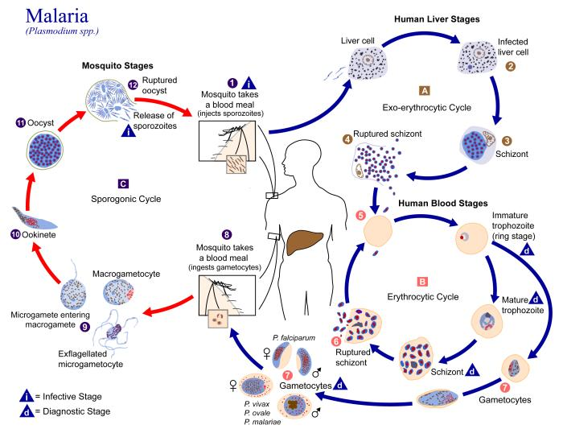

Slide 3
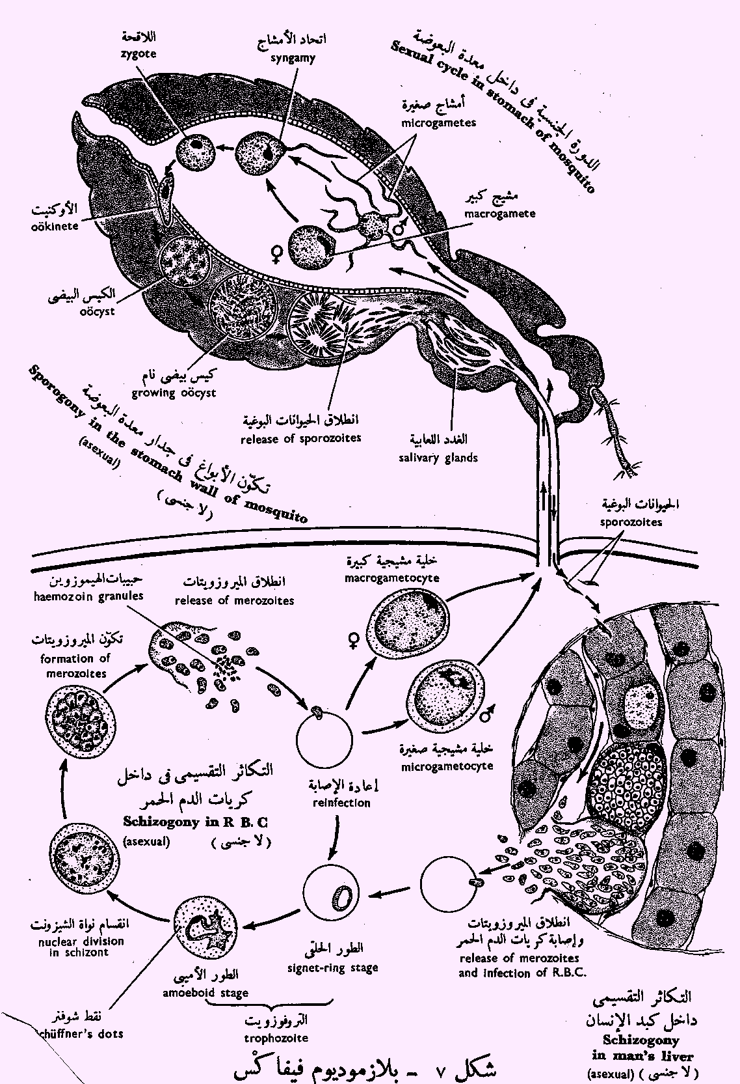

Slide 4
The life cycles of these species are basically similar:
The life cycle includes both sexual and asexual reproduction. The life cycle can best be understood by starting with the zygote in the gut of a mosquito.
A-The life cycles in the mosquito
1-The zygote becomes motile and passes through the lining and wall of the stomach or midgut of the mosquito and is now called an ookinete.
2-The ookinete then rounds up and encysts on the outside of the gut wall and is called an oocyst.

Slide 5
3-After several days of growth, the oocyst divides internally to form several hundred sporozoites.
4-The sporozoites escape by rupturing the external wall of the oocyst and migrate through the hemocoel to the salivary glands of the mosquito.

Slide 6
B-The life cycles in the human
1-When a mosquito bites a human, the sporozoites with the salivary secretions are injected into the bloodstream are eventually carried to the liver.
2-Sporozoites enter host cells. Inside the host liver cells, the sporozoites transform into amoeboid multinuclear schizonts and feed upon the contents of the host liver cells.
3-The schizonts reproduce asexually to form many merozoites, then escape from the liver cells.

Slide 7
4---a-In some cases, invade other liver cells to repeat the process.
4---b- or merozoites escape into the bloodstream and penetrate erythrocytes.
5- The merozoites undergo further asexual reproduction within the erythrocytes.
6- Later, the merozoites rupture the wall of the erythrocytes, escape into the blood, and enter other erythrocytes. This multiplication process can be repeated several times, so that an enormous number of parasites are produced within the host.

Slide 8
(The rupture of the erythrocytes by the merozoites also releases accumulated toxic wastes from the parasites, and these wastes cause the symptomatic chills and fever commonly associated with human malaria.)
7- Some of the merozoites develop into sexual forms. These sexual forms develop within the erythrocytes and become microgametocytes (male) and macrogametocytes (female).
8- If a mosquito bites an infected host and ingests infected erythrocytes, the gametocytes pass into the mosquito stomach, where they mature into microgarnetes and macrogametes. After fertilization, the zygotes, invade the gut wall of the mosquito to start the cycle again.

